Slide 1
REST

Slide 2
Introduction
REST is a set of principles that define how Web standards, such as HTTP and URIs, are supposed to be used
The promise is that if you adhere to REST principles while designing your application, you will end up with a system that exploits the Web’s architecture to your benefit.

Slide 3
Key principles
Give every “thing” an ID
Link things together
Use standard methods
Resources with multiple representations
Communicate statelessly

Slide 4
Give every “thing” an ID
Everything that should be identifiable should get an ID
EX: on the Web, there is a unified concept for IDs: The URI. URIs make up a global namespace, and using URIs to identify your key resources means they get a unique, global ID.
The main benefit of a consistent naming scheme for things is that you don’t have to come up with your own scheme

Slide 5
ID Everything
Taking the idea of identifying everything that is worth being identified further leads to the creation of resources that you usually don’t see in a typical application design
A process or process step, a sale, a negotiation, a request for a quote — these are all examples of “things” that merit identification.

Slide 6
Examples
http://example.com/customers/1234
http://example.com/orders/2007/10/776654
http://example.com/products/4554
http://example.com/processes/salary-increase-234
Collections:
  http://example.com/orders/2007/11
  http://example.com/products?color=green

Slide 7
ID Everything
To summarize the first principle: Use URIs to identify everything that merits being identifiable,
  specifically, all of the “high-level” resources that your application provides, whether they represent individual items, collections of items, virtual and physical objects, or computation results.

Slide 8
Link things together
Links are something we’re all familiar with from HTML, but they are in no way restricted to human consumption

Slide 9
Example
Consider the following made-up XML fragment:
<order self='http://example.com/customers/1234' >
<amount>23</amount>
<product ref='http://example.com/products/4554' />
<customer ref='http://example.com/customers/1234' />
</order>
If you look at the product and customer links in this document, you can easily imagine how an application that has retrieved it can “follow” the links to retrieve more information.
The beauty of the link approach using URIs is that the links can point to resources that are provided by a different application, a different server, or even a different company on another continent
because the naming scheme is a global standard, all of the resources that make up the Web can be linked to each other.

Slide 10
Hypermedia and Dynamic Applications
There is an even more important aspect to the hypermedia principle — the “state” part of the application
In short, the fact that the server (or service provider, if you prefer) provides a set of links to the client (the service consumer) enables the client to move the application from one state to the next by following a link.

Slide 11
So: Link things together
To summarize this principles: Use links to refer to identifiable things (resources) wherever possible. Hyperlinking is what makes the Web the Web.

Slide 12
Use standard methods
There was an implicit assumption in the discussion of the first two principles: that the consuming application can actually do something meaningful with the URIs.
If you see a URI written on the side of a bus, you can enter it into your browser’s address field and hit return — but how does your browser know what to do with the URI?
It knows what to do with it because every resource supports the same interface, the same set of methods (or operations, if you prefer).

Slide 13
HTTP Verbs are Standard Methods
HTTP calls these verbs, and in addition to the two everyone knows (GET and POST), the set of standard methods includes PUT, PATCH, DELETE, HEAD and OPTIONS.
The meaning of these methods is defined in the HTTP specification, along with some guarantees about their behavior.

Slide 14
GET
Because GET’s semantics are defined in the specification, you can be sure that you have no obligations when you call it — this is why the method is called “safe”.
GET supports very efficient and sophisticated caching, so in many cases, you don’t even have to send a request to the server.
You can also be sure that a GET is idempotent — if you issue a GET request and don’t get a result, you might not know whether your request never reached its destination or the response got lost on its way back to you (multiple applications of the operation does not change the result)
The idempotence guarantee means you can simply issue the request again.
Idempotence is also guaranteed for PUT (which basically means “update this resource with this data, or create it at this URI if it’s not there already”) and for DELETE (which you can simply try again and again until you get a result — deleting something that’s not there is not a problem).
POST, which usually means “create a new resource”, can also be used to invoke arbitrary processing and thus is neither safe nor idempotent.

Slide 15
Use standard Methods?
If you expose your application’s functionality (or service’s functionality, if you prefer) in a RESTful way, this principle and its restrictions apply to you as well.

Slide 16
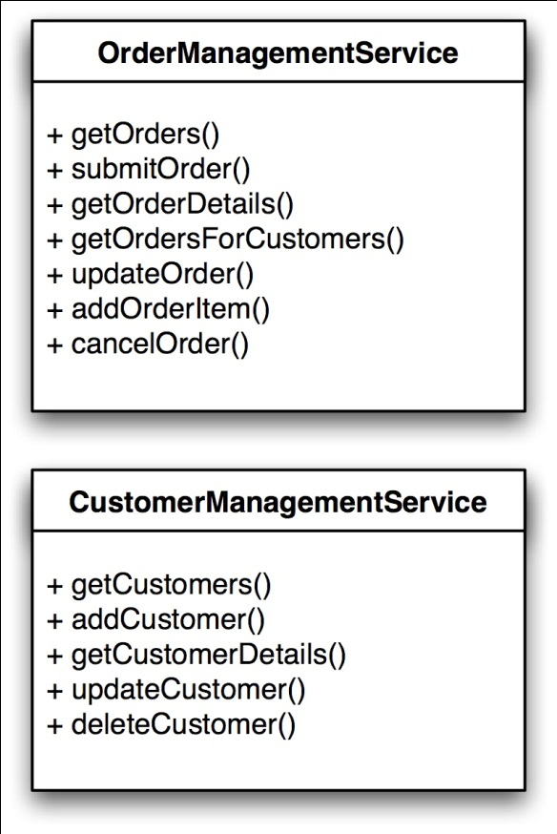
Example
Consider the following example of a simple procurement scenario

Slide 17
Interfaces
You can see that there are two services defined here (without implying any particular implementation technology).
The interface to these services is specific to the task — it’s an OrderManagement and CustomerManagement service we are talking about.
If a client wants to consume these services, it needs to be coded against this particular interface — there is no way to use a client that was built before these interfaces were specified to meaningfully interact with them.
The interfaces define the services’ application protocol.

Slide 18
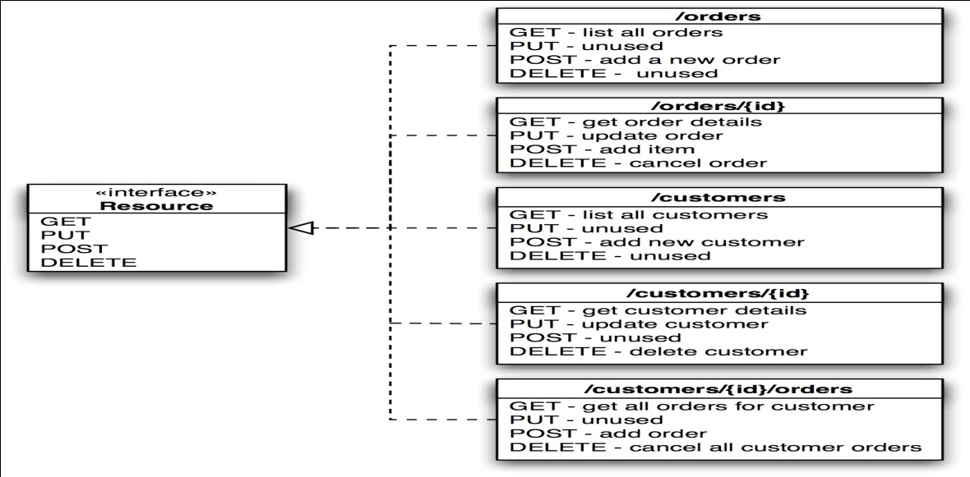
Restful Interface
In a RESTful HTTP approach, you would have to get by with the generic interface that makes up the HTTP application protocol.
You could re-engineer the service interface as follows

Slide 19
Restful Interface
You can see that what have been specific operations of a service have been mapped to the standard HTTP methods — and to disambiguate new resources were created
A GET on a URI that identifies a customer is just as meaningful as a getCustomerDetails() operation.

Slide 20
So: Use standard methods
To summarize: For clients to be able to interact with your resources, they should implement the default application protocol (HTTP) correctly, i.e. make use of the standard methods GET, PUT, POST, DELETE.

Slide 21
Resources with multiple representations
We’ve ignored a slight complication so far: how does a client know how to deal with the data it retrieves, e.g. as a result of a GET or POST request?
The approach taken by HTTP is to allow for a separation of concerns between handling the data and invoking operations.
In other words, a client that knows how to handle a particular data format can interact with all resources that can provide a representation in this format.
Ex: Using HTTP content negotiation, a client can ask for a representation in a particular format:
GET /customers/1234 HTTP/1.1
Host: example.com
Accept: application/vnd.mycompany.customer+xml

Slide 22
Resources with multiple representations
The result might be some company-specific XML format that represents customer information. If the client sends a different request, e.g. one like this:
GET /customers/1234 HTTP/1.1
Host: example.com
Accept: text/x-vcard
The result could be the customer address in VCard format.
This illustrates why ideally, the representations of a resource should be in standard formats — if a client “knows” both the HTTP application protocol and a set of data formats, it can interact with any RESTful HTTP application in the world in a very meaningful way.

Slide 23
Resources with multiple representations
There is another significant benefit of having multiple representations of a resource in practice:
  If you provide both an HTML and an XML representation of your resources, they are consumable not only by your application, but also by every standard Web browser — in other words, information in your application becomes available to everyone who knows how to use the Web.

Slide 24
So: Resources with multiple representations
Summary: Provide multiple representations of resources for different needs.

Slide 25
Communicate statelessly
First of all, it’s important to stress that although REST includes the idea of statelessness, this does not mean that an application that exposes its functionally cannot have state — in fact, this would render the whole approach pretty useless in most scenarios.
REST mandates that state be either turned into resource state, OR kept on the client.
In other words, a server should not have to retain some sort of communication state for any of the clients it communicates with beyond a single request.
The most obvious reason for this is scalability — the number of clients interacting would seriously impact the server’s footprint if it had to keep client state.

Slide 26
Communicate statelessly
But there are other aspects that might be much more important:
  The statelessness constraint isolates the client against changes on the server as it is not dependent on talking to the same server in two consecutive requests.
  A client could receive a document containing links from the server, and while it does some processing, the server could be shut down, its hard disk could be ripped out and be replaced, the software could be updated and restarted — and if the client follows one of the links it has received from the server, it won’t notice.

Slide 27
Summary
A RESTful HTTP approach to exposing functionality is different from RPC, Distributed Objects (like RMI and ICE), and SOAP based Web services;
  it takes some mind shift to really understand this difference.
Being aware about REST principles is beneficial whether you are building applications that expose a Web UI only or want to turn your application API into a good Web citizen.
The sweet spot of REST is exposing data externally.

Slide 28
OpenAPI (Swagger)
Delivering APIs which share common behaviors, patterns and a consistent RESTful interface will greatly ease the work of the people who build them and the consumers who want to use them.
The OpenAPI Initiative (OAI) was created by a consortium of forward-looking industry experts who recognize the immense value of standardizing on how REST APIs are described.
The OAI is focused on creating, evolving and promoting a vendor neutral description format.
SmartBear Software is donating the Swagger Specification directly to the OAI as the basis of this Open Specification.
APIs form the connecting glue between modern applications. Nearly every application uses APIs to connect with corporate data sources, third party data services or other applications.
Creating an open description format for API services that is vendor neutral, portable and open is critical to accelerating the vision of a truly connected world.

Slide 29
OpenAPI
Tutorial: https://idratherbewriting.com/learnapidoc/pubapis_openapi_tutorial_overview
An OpenAPI document that conforms to the OpenAPI Specification is itself a JSON object, which may be represented either in JSON or YAML format.

Slide 30
OpenAPI
Each level in YAML (defined by a two-space indent) is an object.
In the following code, california is an object. animal, flower, and bird are properties of the california object.
california:
animal: Grizzly Bear
flower: Poppy
bird: Quail

Slide 31
OpenAPI
Here’s what this looks like in JSON:
{
"california": {
"animal": "Grizzly Bear",
"flower": "Poppy",
"bird": "Quail"
}
}

Slide 32
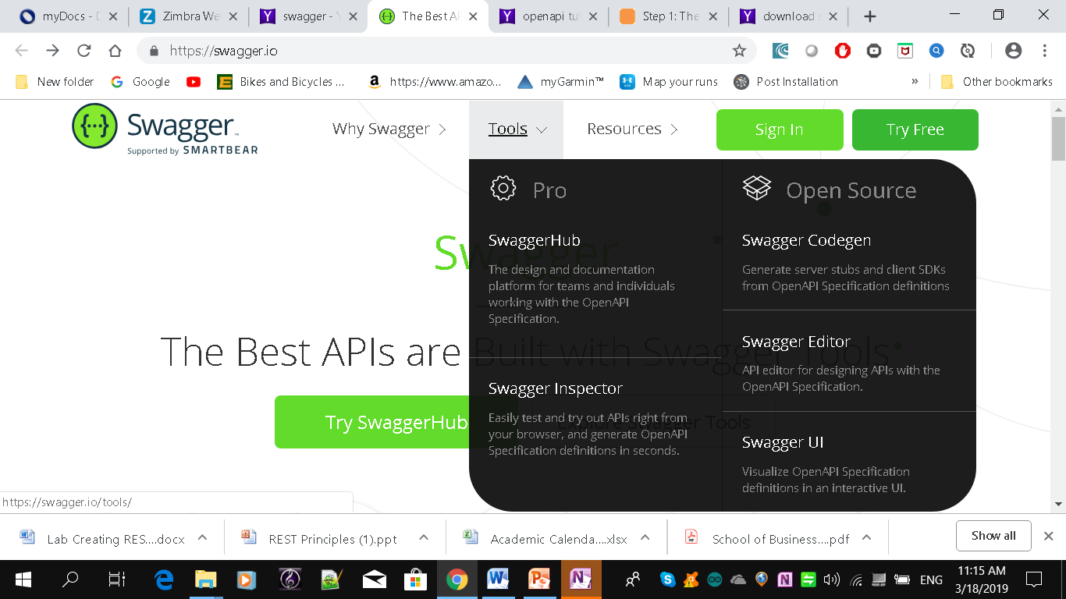
Swagger Editor

Slide 33
Swagger Editor
Npm install swagger-editor locally
Or use online version

Slide 34
Example OpenAPI file
swagger: "2.0"
info:
version: "0.0.1"
title: Hello World App
# during dev, should point to your local machine
host: localhost:10010
# basePath prefixes all resource paths
basePath: /
#
schemes:
# tip: remove http to make production-grade
- http
- https
# format of bodies a client can send (Content-Type)
consumes:
- application/json
# format of the responses to the client (Accepts)
produces:
- application/json

Slide 35
Example OpenAPI file
paths:
/hello:
# binds a127 app logic to a route
x-swagger-router-controller: hello_world
get:
description: Returns 'Hello' to the caller
# used as the method name of the controller
operationId: hello
parameters:
- name: name
in: query
description: The name of the person to whom to say hello
required: false
type: string
responses:
"200":
description: Success
schema:
# a pointer to a definition
$ref: "#/definitions/HelloWorldResponse"
# responses may fall through to errors
default:
description: Error
schema:
$ref: "#/definitions/ErrorResponse"
/swagger:
x-swagger-pipe: swagger_raw

Slide 36
Example OpenAPI file
# complex objects have schema definitions
definitions:
HelloWorldResponse:
required:
- message
properties:
message:
type: string
ErrorResponse:
required:
- message
properties:
message:
type: string

Slide 37
OpenAPI Object
Add the first root-level property for the specification document: openapi.
In the openapi object, indicate the version of the OpenAPI spec to validate against. The latest version is 3.0.2.
openapi: "3.0.2"

Slide 38
OpenAPI Info Object
The info object contains basic information about your API, including the title, a description, version, link to the license, link to the terms of service, and contact information.
Many of the properties are optional.

Slide 39

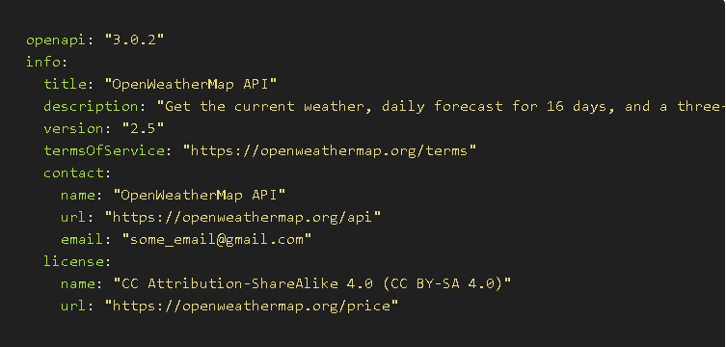
Info Object

Slide 40
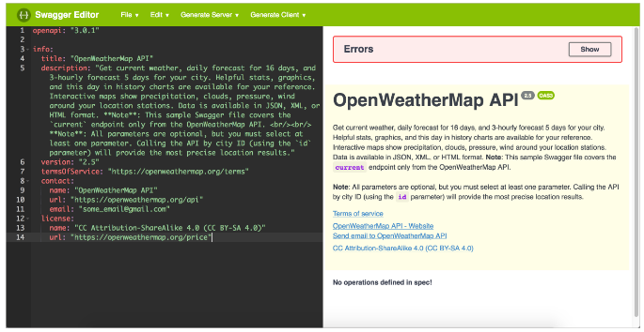
In Swagger

Slide 41
OpenAPI Servers Object
In the servers object, you specify the basepath used in your API requests. The basepath is the part of the URL that appears before the endpoint.

Slide 42
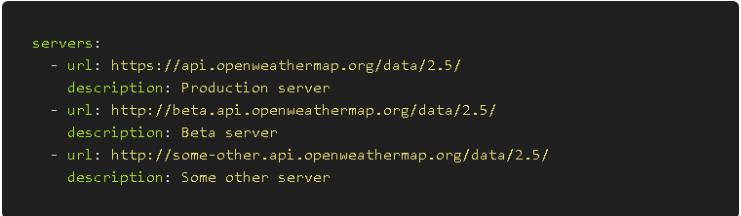
OpenAPI Servers Object

Slide 43
OpenAPI Paths Object
The paths object contains the meat of your API information.
The paths object has several sub-objects: a path items object, an operations object, and more.

Slide 44
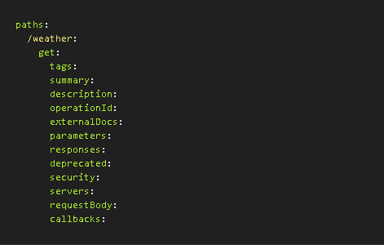
OpenAPI Paths Object

Slide 45
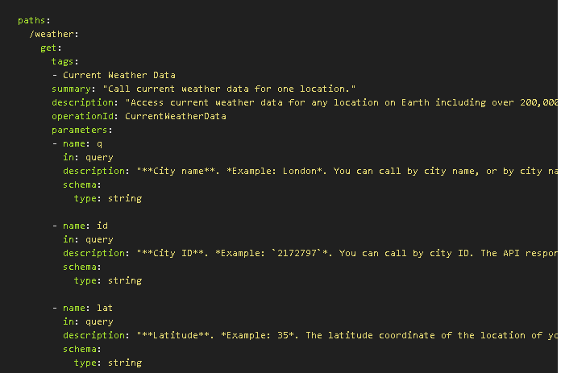
ExamplePaths Object

Slide 46
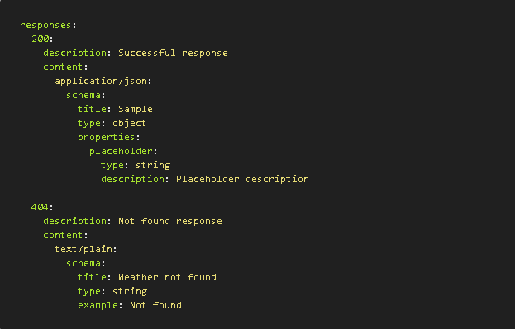
Example Response Object

Slide 47
OpenAPI Components Object
The components object is unique from the other objects in the OpenAPI specification.
In components, you store re-usable definitions that might appear in multiple places in your specification document.

Slide 48
OpenAPI Security Object
REST APIs can use different security approaches to authorize requests. Swagger UI supports four authorization schemes:
  API key
  HTTP
  OAuth 2.0
  Open ID Connect

Slide 49
OpenAPI Tags Object
The tags object allows you to arrange the paths (endpoints) into named groups in the Swagger UI display.

Slide 50
OpenAPI External Docs Object
The externalDocs object lets you link to external documentation. You can also provide links to external docs in the paths object.

Slide 51
Example REST Web Services
Google maps etc
Amazon
Social Media (Facebook, Twitter, Flickr, Del.icio.us, youtube etc)
Look at Netbeans etc
http://www.programmableweb.com/apis

Slide 52
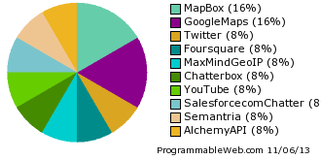
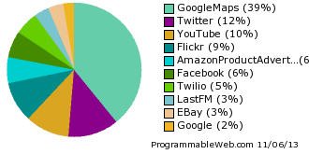
Top Ten Web Service APIs for Mashups (last 2 weeks/all time)

Slide 53
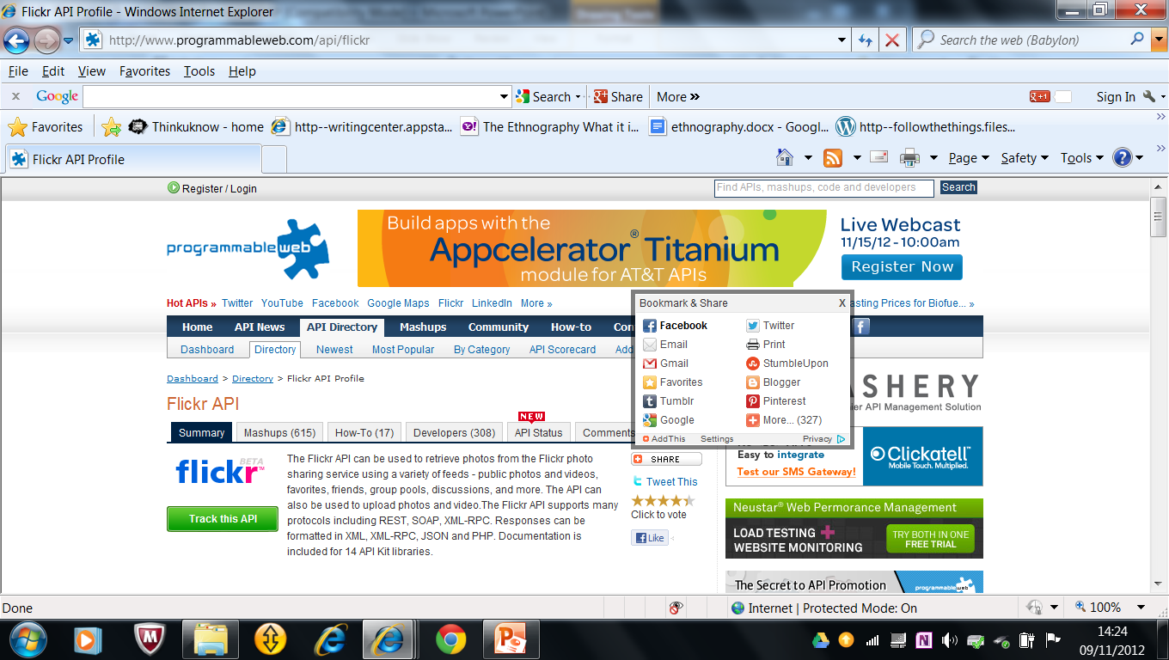
Flickr

Slide 54
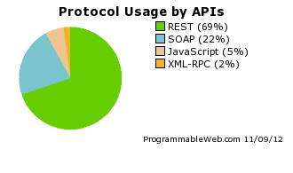
Top Protocol

